Slide 1



Online Prospectus
2021-22

Slide 2

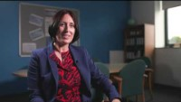
Welcome from the Headteacher

Slide 3
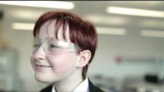
Our School Values

Slide 4

Celebrating Success: Recognising Our Values

Slide 5
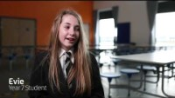
Year 7 Discussing their Transition

Slide 6
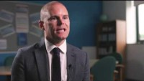
Mr Abraham – Deputy Headteacher

Slide 7
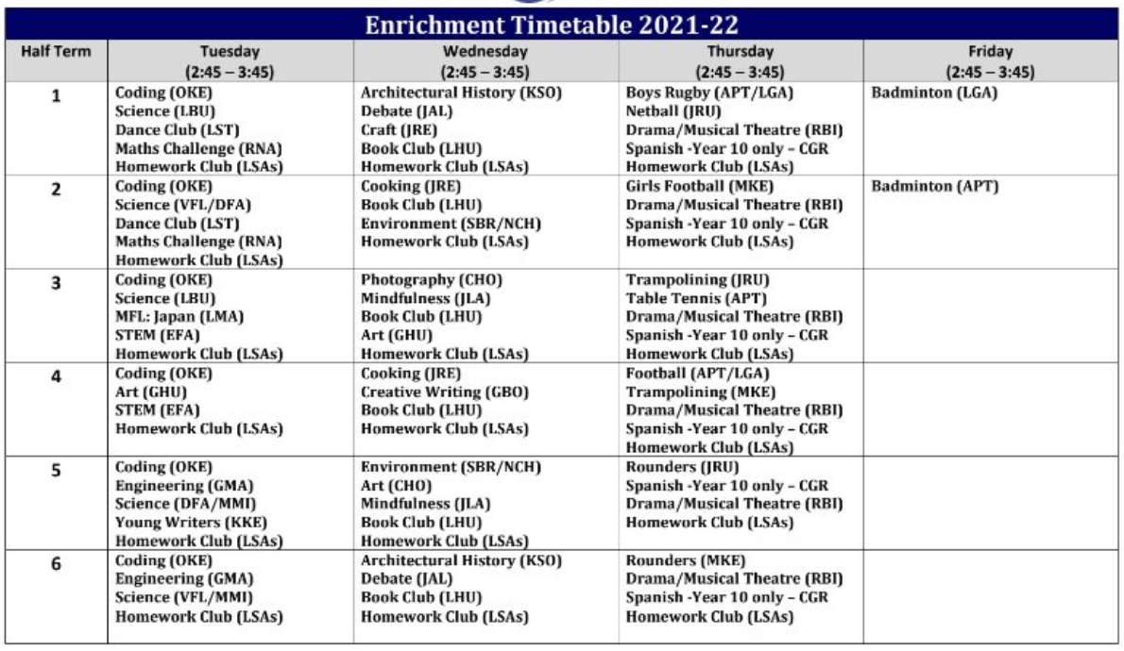
Enrichment Opportunities

Slide 8
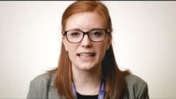
Mrs Donkin – Assistant Headteacher

Slide 9
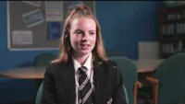
Year 8 Discussing their Transition

Slide 10
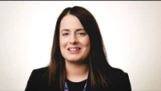
Miss Hanquinioux – Assistant Headteacher

Slide 11
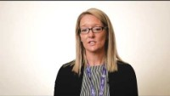
Mrs Moulton – Director of Pastoral Care

Slide 12
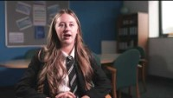
Our Wonderful Year 11 Students

