Slide 1



Personal Development
Year 8 Residential
5th June 2023

Slide 2
Why?
Character building/Maturing Rewarding students who have made positive choices in school around their behavior and attendance Set up final stage of KS3

Slide 3
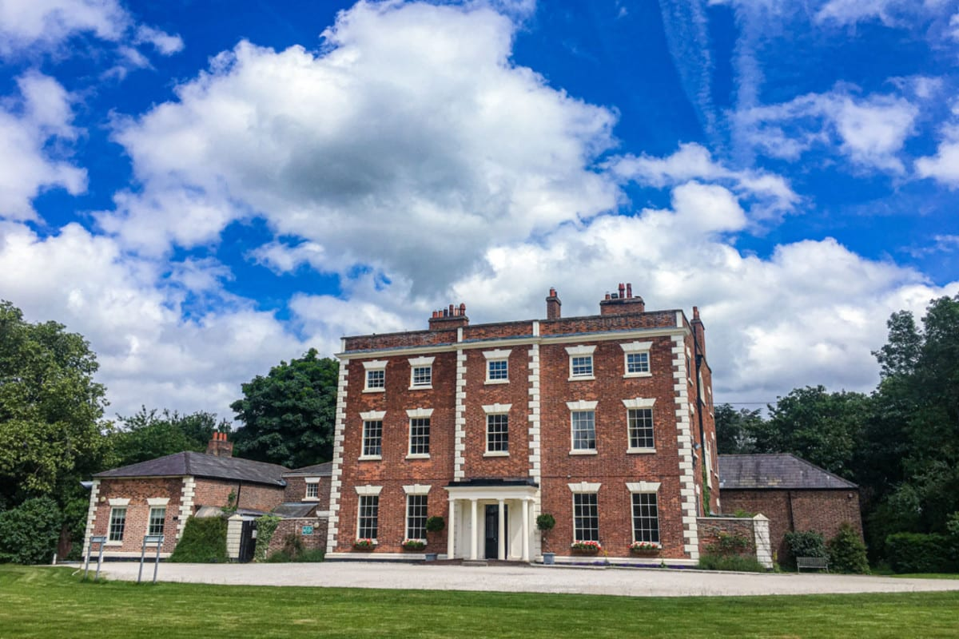
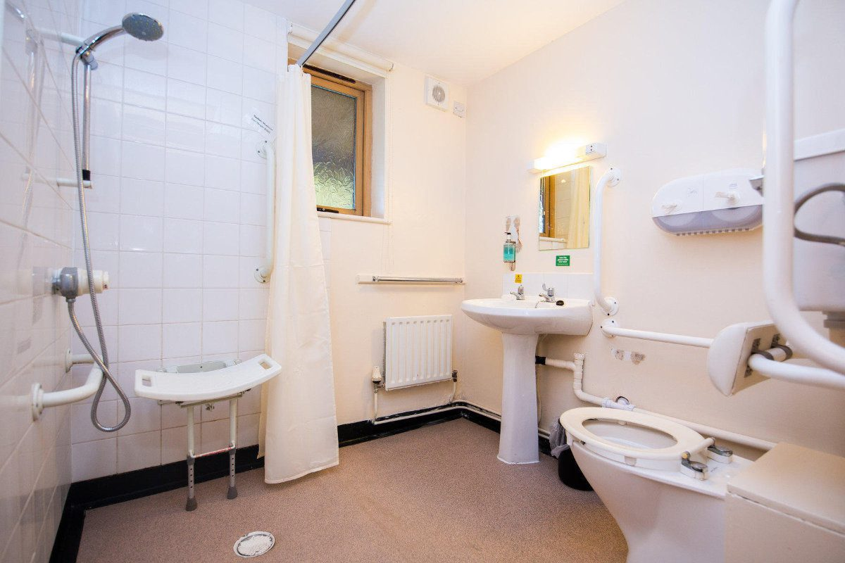
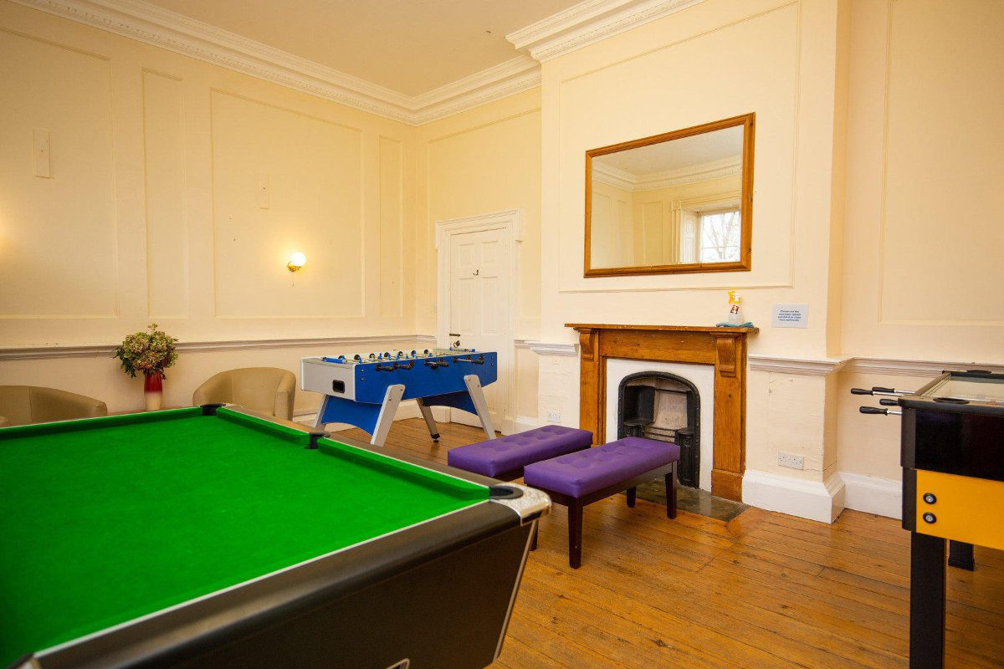
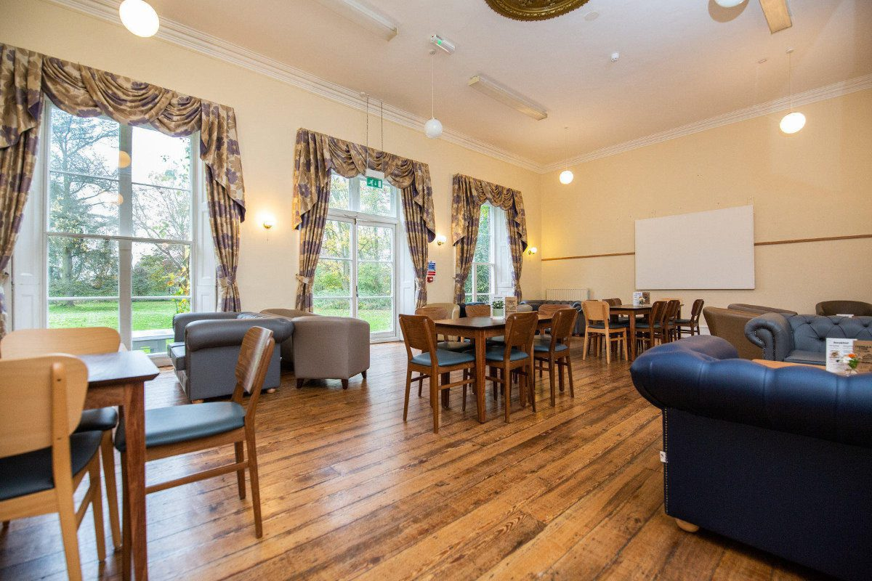
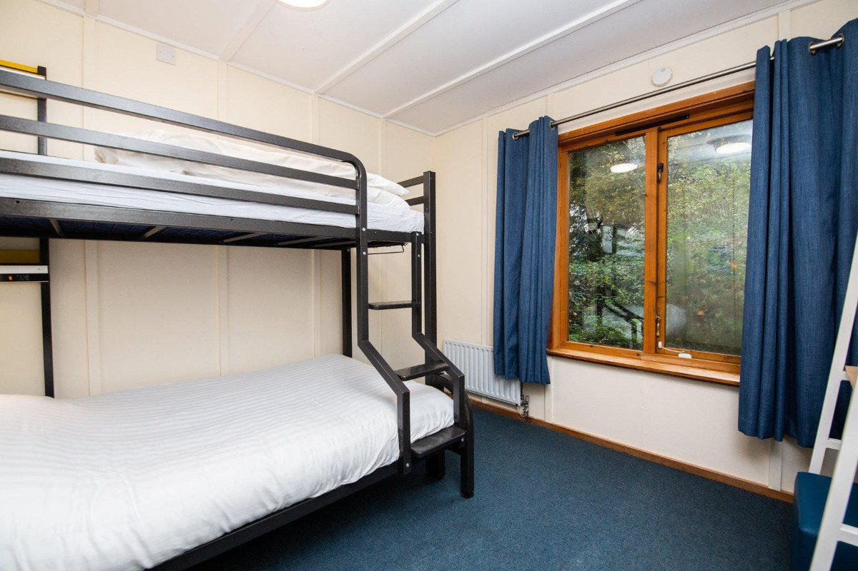
Where?
Trafford Hall- Chester 14 acre site Lounge Formal Dining room Meeting Rooms Games rooms- Pool, Table football, Darts Single gender bedroom corridors Dorm rooms all en-suite

Slide 4
Expectations - Passport to Attend
Your Son/Daughter needs to meet the following criterion between now and the departure date: 5 out of 6 95% Attendance Be punctual to school No Exclusions 0 C3 Room removals Meet uniform expectations Achieve Legend of the week, SLT stamp or Headteacher stamp for exceptional work/effort Attendance on the residential can be withdrawn at any point by Headteacher discretion

Slide 5
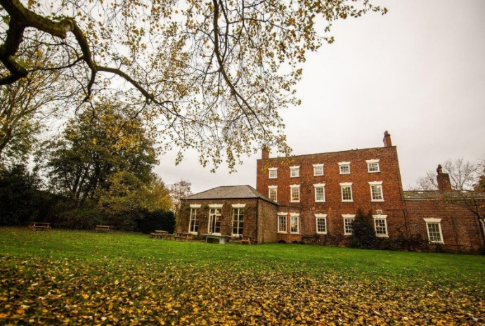
Itinerary
 | Monday | Tuesday | Wednesday
Breakfast | Arrive in Chester | Provided | Provided
Morning | Orienteering in the Grounds | Archery | Outdoor Cooking
Lunch | Provided | Provided | Lunch (packed)
Afternoon | River Dipping | Shelter Building | Depart
Dinner | Provided | Provided
Evening | Fire Building | Night Walk

Slide 6

Board Basis
Price is Full Board (Breakfast Lunch and Dinner) Breakfast Buffet breakfast consisting of cereals, toast with a range of toppings and fruit. Lunch Lunch is a sandwich, fruit, drinks and snacks Dinner Sit down 2 course meal in the dining room example Main: Lasagne, Desert: Apple Pie (vegetarian option and other dietary requirements will be met)

Slide 7
What’s included in the cost
Included: Transportation - coach to and from Chester, with seatbelts Accommodation for 2 nights in en-suite rooms, 3 days Full board- Breakfast, Lunch and Dinner Activities and Qualified Instructors Insurances

Slide 8
Price
Total per head on 100 students going £151 + 23.85 = £180 Total per head on 85 students going (2 coaches) = £200 Total per head on 75 students going (2 coaches) = £225 To secure your child's place a non-refundable deposit of £75 is required by – Friday 2nd December Payment schedule - 6th January £50 - 24th February £50 - Final Payment- 31st March remaining balance – largest possible Amount remaining = £50

Slide 9
Any Questions
Any questions? Please don’t hesitate to contact me andy.petrie@consilium-at.com

